Slide 1

Data Science Bootcamp
Name: Muhammad Hamid Khan
Cohort: White 5

Slide 2

Data Bank System Node Analysis
The Data Bank system is structured into a multitude of nodes, interconnected to create a robust network. This intricate system is analyzed through various parameters to ensure an efficient allocation of resources and optimal connectivity. It is crucial to understand the unique nodes, their regional distribution, the customer allocation per region, and the frequency of reallocations to different nodes. Such insights are instrumental in managing the sprawling digital infrastructure that sustains the world's ever-growing data needs.
Detailed analysis of these nodes can reveal patterns that inform strategic decisions, enhance service reliability, and maintain customer satisfaction. System administrators and data analysts play a critical role in dissecting this information, identifying areas for improvement, and forecasting future requirements. By examining these nodes, we can start to appreciate the complex fabric that makes up the Data Bank’s digital ecosystem.

Slide 3
Node Distribution and Customer Allocation
Unique Node Count
Regional Node Numbers
Customer Allocation
Understanding the number of unique nodes in the Data Bank system is the foundation of the network analysis. Nodes are the pivotal points of data transfer and their count reflects the system's capacity and complexity.
The distribution of nodes across regions is vital to ensure data redundancy and efficient handling of traffic. Higher numbers of nodes in a region could correlate with greater demand or strategic importance.
Customers are unevenly allocated across regions, with certain areas boasting a higher concentration. This distribution impacts the load on the system and dictates resource planning and regional optimization strategies.
Region 1
110 Nodes
350 Customers
Region 2
95 Nodes
250 Customers
Region 3
78 Nodes
200 Customers

Slide 4
Customer Reallocations and Regional Reallocation Patterns
1
Reallocations Overview
The reallocation timeline reveals insights into customer experience and node performance. Tracking the average days of customer reallocation uncovers the dynamic nature of node assignments and their lifespans.
2
Reallocations By Node
Analysing reallocation frequencies on a per-node basis can indicate the nodes' stability or volatility, shedding light on possible technical improvements or the need for capacity upgrades.
3
Regional Reallocation Rates
Reviewing regional reallocation rates with percentile analysis allows for a statistically comprehensive understanding of how customer-node relationships differ from one region to another.
Region
Median Reallocation Days
80th Percentile
95th Percentile
Region A
45
70
90
Region B
30
55
75
Region C
50
65
85

Slide 5
Understanding Running Balance Calculations
1
Initiate Calculation
This phase involves setting up a Common Table Expression (CTE) that serves as a temporary result set. The CTE constructs the groundwork from where the running balance will be computed, accounting for transactions up to the last day of the previous month.
1
Compute Cumulative Total
Within the CTE, a window function tallies the transaction amount, partitioned by customer IDs and ordered by transaction date. The resulting ordered sum, known as the running balance, represents the continuous total as new transactions occur.
1
Render Results
After calculating the running balance, the final step is fetching the data. A SELECT statement serves this purpose by retrieving the full set of results inclusive of the running balance for further analysis.

Slide 6
Transactional Types and Totals
Transaction Diversity
Count & Amount
Growth Opportunities
The variety of transactions customers undertake is significant. These include deposits, withdrawals, and purchases - each serving as a pulse point for customer financial activity. Our analysis categorizes these transactions to show prevalent trends.
Distinguishing the frequency and monetary value of each transaction type provides a layered understanding of financial dynamics. Identifying these metrics assists in tailoring services to meet customer transaction preferences.
Customers are unevenly allocated across regions, with certain areas boasting a higher concentration. This distribution impacts the load on the system and dictates resource planning and regional optimization strategies.

Slide 7
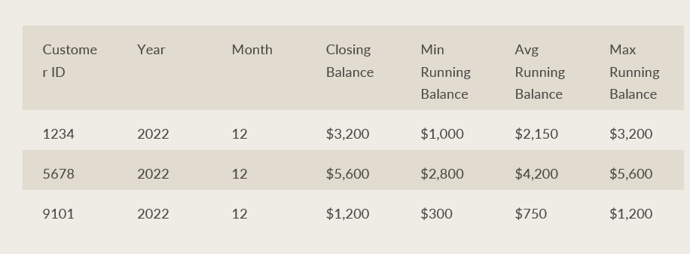
Comparing Balance Statistics per Customer
The analyzation stage delves into aggregating the running balance for refining customer insights. A nested Common Table Expression (CTE) is deployed to extract maximum, average, and minimum running balance values. By segmenting these values per month and year, analysts can observe seasonal patterns, spending behaviors, and the fiscal health of customers — vital for tailored customer engagement and risk mitigation.

Slide 8
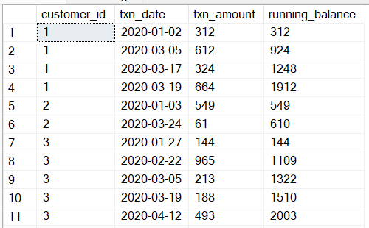
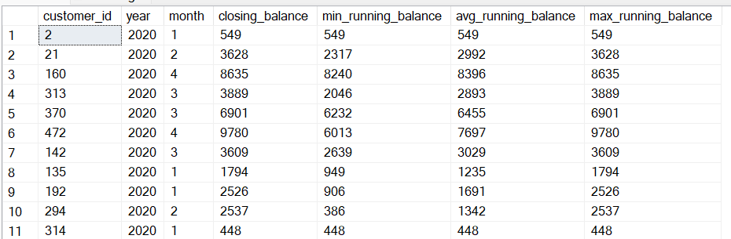
Data Allocation Challenge
Calculate the running customer balance up to the end of the previous month
There are total 1720 rows in the, few rows are mentioned below as sample
Calculate the minimum, average, and maximum values of the running balance for each customer
There are total 1720 rows in the, few rows are mentioned below as sample

Slide 9
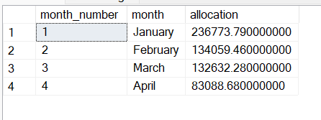
Extra Challenge
This SQL query meticulously computes monthly earnings for bank customers by analysing transaction data, factoring in a 6% annual interest rate. It adjusts earnings by setting negative values to zero, ensuring allocations are non-negative. Results are aggregated and sorted by month for clarity.

Slide 10
Monthly Earnings and Interest Allocation
1
Monthly Summation
The calculations start with a summation of deposits and withdrawals to compute a net figure for each month. This monthly amount is pivotal in understanding customer activity patterns and predicting future cash flows within the banking system.
1
Compute Cumulative Total
Finance experts then apply interest rates to the adjusted monthly amounts, creating an estimate for the interest earnings or charges that customers accumulate over a month. This step introduces the time-value of money concept, necessary for sophisticated finance analysis.

